Slide 1
Working with Bash Scripts
Customize the Bash Shell Environment
Identify Scripting and Programming Fundamentals
Write and Execute a Simple Bash Script
Incorporate Control Statements in Bash Scripts

Slide 2

Topic A: Customize the Bash Shell Environment
Exam Objectives:
1.6 Given a scenario, configure localization options.
4.4 Given a scenario, analyze and troubleshoot application and hardware issues.
5.1 Given a scenario, deploy and execute basic Bash scripts.

Slide 3
Shell Environment
The mechanism by which a shell maintains settings and other behavioral details about the shell.
Shell creates environment when starting new session.
Uses environment's settings to determine how to interact with user.
Shell spawning creates a new session.
New session is a copy (child process).
Child process is spawned when user enters command.
Child process becomes new process.
Child process can create more processes, and so on.
Each process passes environment details onto next child.

Slide 4
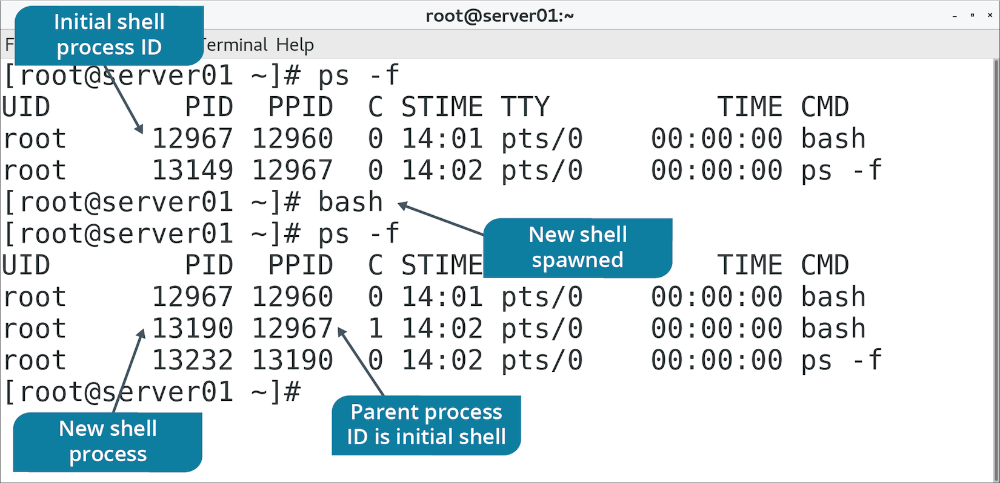
Shell Spawn

Slide 5
Scripts
Computer programs that automate the execution of tasks for a particular runtime/shell environment.
Written in scripting languages.
Subset of programming languages.
Integrate with other programs and OS components.
Not always full-fledged programs.
Help achieve automation.

Slide 6
Variables
Entities whose values change from time to time.
Most set by OS on login or when shell is first invoked.
Key components comprising shell environment.
Change variables to change shell environment.
Variables can be either shell or environment.
Shell variable values are not passed on to child processes.
Environment variable values are.

Slide 7
Environment Variables
A variable that is passed onto child shell processes.
Consists of a name (uppercase) and a value.
Referenced as key–value pairs.
Format: KEY=value
Multiple values: KEY=value1:value2

Slide 8
The export Command (Slide 1 of 2)
Can change shell variable into environment variable.
Example: export SHL_VAR to make it an environment variable.
Can also change environment variable values.
export SHL_VAR="New value"
Sets value for all child processes.
Add export to .bash_profile to set value for all future sessions.
Modify in /etc/skel/ for new user automation.
Add export to /etc/profile.d/ for system-wide changes.

Slide 9
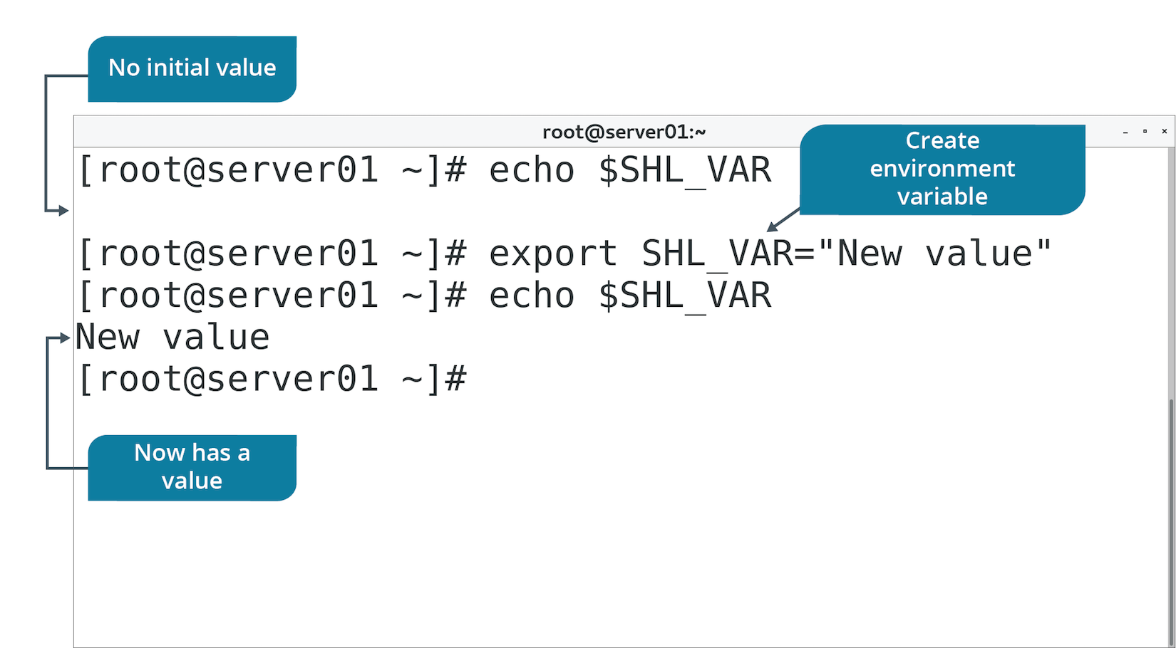
The export Command (Slide 2 of 2)

Slide 10
The env Command (Slide 1 of 2)
Runs a command with modified environment variables.
You supply variable and value to change it to.
If variable doesn't exist, it's added to environment.
You also supply command to run.
Use –u option to remove variable from environment.
Use to override values or add them to child processes.
Prints environment variables when not given arguments.

Slide 11
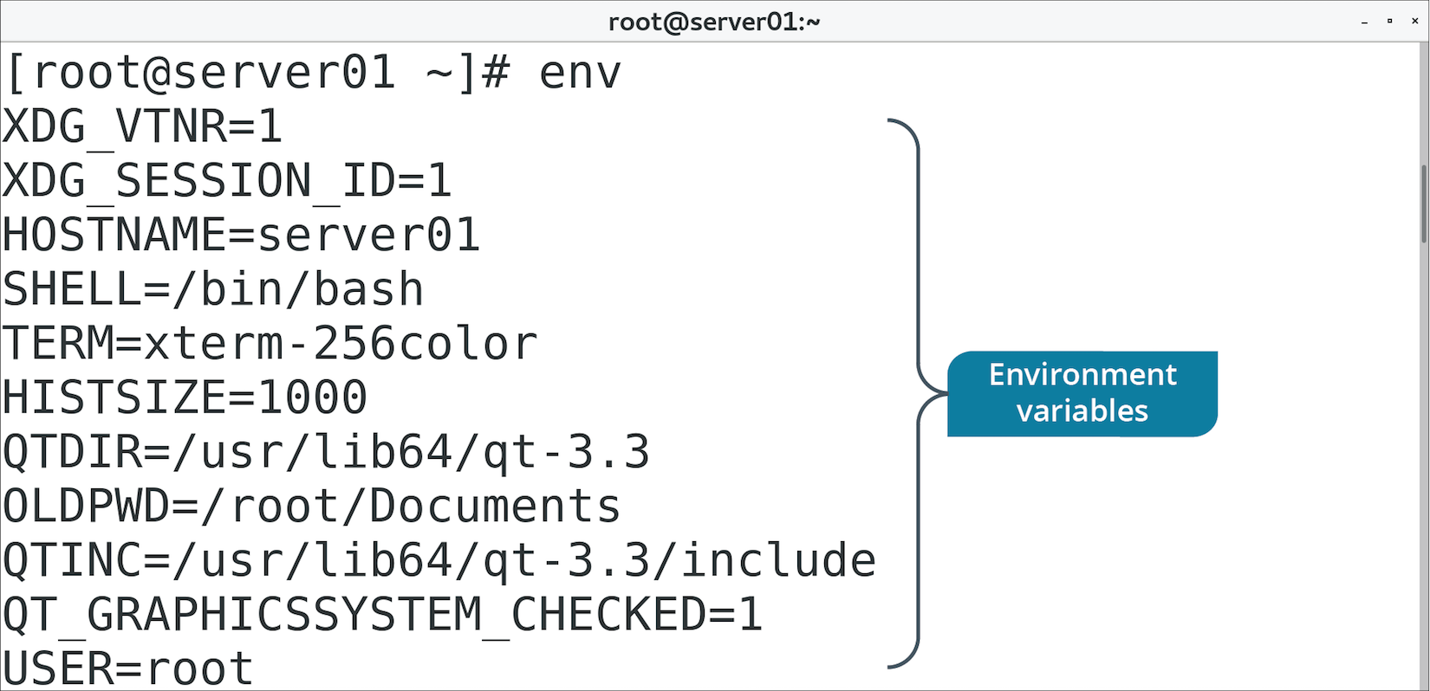
The env Command (Slide 2 of 2)

Slide 12
Search Paths
A sequence of various directory paths that is used by the shell to locate files.
Can be assigned to PATH environment variable.
PATH lists directory names separated by colons.
You can add a new path, modify a path, delete a path.
Directories containing executables are assigned to PATH variable.
Enables you to enter executable name without full path.
PATH searches directories for name of executable.

Slide 13
HISTFILESIZE
Example of a shell variable.
Sets max number of lines in history file.
Sets lines displayed by running history command.
Example: Assign value 20 to variable.
File is truncated to 20 lines.
Default value is 1000.

Slide 14
The alias Command (Slide 1 of 2)
Another way to customize shell environment.
Generates command-line aliases.
Shorthand for larger expressions.
Create a short string to represent longer command with arguments.
Example: myls alias to execute ls -al command.
Bash shell maintains list of aliases.
unalias removes aliases.
Add to .bashrc or .bash_aliases to persist.

Slide 15
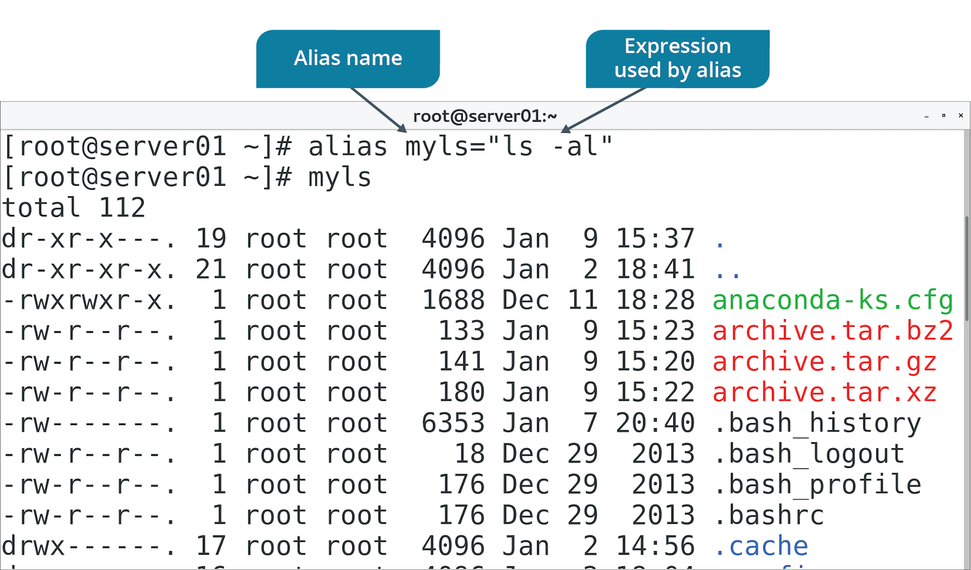
The alias Command (Slide 2 of 2)

Slide 16
The time Command (Slide 1 of 2)
Reports how long it took to execute a command.
Also provides additional stats about I/O, memory, etc.
Provide command you want to time as an argument to time
Default output to stderr:
Real time elapsed.
User CPU time.
System CPU time.
Can help you optimize frequent tasks.
Some commands are faster than others.

Slide 17
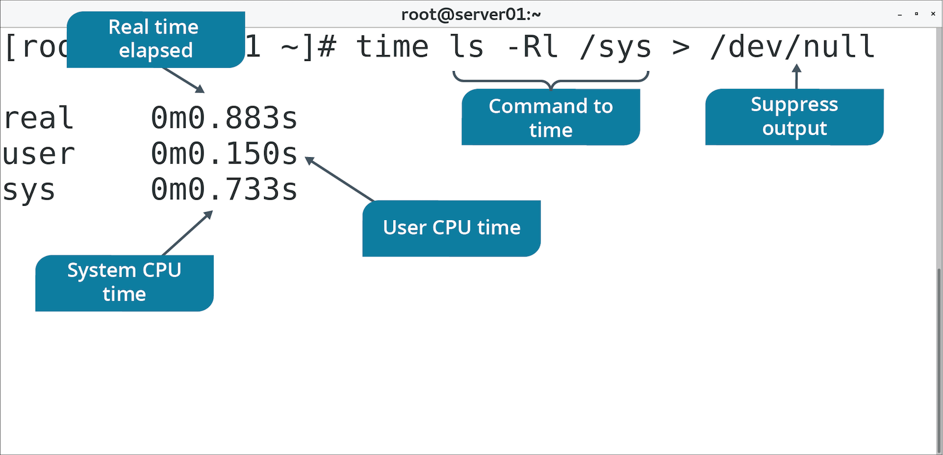
The time Command (Slide 2 of 2)

Slide 18
Environment and Shell Troubleshooting
Check the syntax of any aliases.
Add executable directories to PATH or use ./ to execute programs.
Use export to set variable for all shell instances.
Configure variables in ~/.bash_profile so they're available to all shells.
Edit ~/.bash_profile to change default variables.
Set values for variables that software depends on.

Slide 19
Discussing the Bash Shell Environment

Slide 20
Activity 13-1: Discussing the Bash Shell Environment
You are exploring your local (shell) variables on each system that you manage. The first variable you check is the SHELL variable. How can you check the SHELL variable and what do you expect it to display?
ANSWER:
Check the SHELL variable with echo $SHELL and expect /bin/bash as the output.

Slide 21
Activity 13-1: Discussing the Bash Shell Environment
You have seen other administrators use the export command and you have seen it referred to in documentation for scripts. What does the export command do?
ANSWER:
The export command changes a local (shell) variable into a global variable.

Slide 22
Activity 13-1: Discussing the Bash Shell Environment
You log into a system that seems to have something incorrect in its configuration, but you are having trouble pinpointing why certain paths don't exist and why certain shell variables are set to non-standard values. How can you view all shell variables at once?
ANSWER:
Use the set command with no arguments.

Slide 23
Activity 13-1: Discussing the Bash Shell Environment
You believe either that the PATH variable is incorrectly set or that there are a significant number of commands missing from the system. How can you display the PATH variable value?
ANSWER:
Use the echo $PATH command.

Slide 24
Activity 13-1: Discussing the Bash Shell Environment
Another system administrator has aliased the ls command to ls –la and you don't like to see that much output in a simple ls command. How can you temporarily remove the alias?
ANSWER:
Use the unalias command: unalias ls

Slide 25
Activity: Customizing the Bash Shell Environment
You'll customize your environment to enhance productivity.
You'll minimize command history for security.
You'll add a search path for a new scripts directory.
You'll create an alias for a lengthy command.

Slide 26
Topic B: Identify Scripting and Programming Fundamentals
Exam Objectives:
5.1 Given a scenario, deploy and execute basic Bash scripts.

Slide 27
Bash Scripting
Bash is a powerful scripting language.
Bash scripts can increase efficiency of Linux administration.
Bash scripts can make system calls or leverage user space tools.
Any program you can call at CLI can be invoked in a script.
Also supports logic-based programming elements.

Slide 28
Syntax
The rules that define how you write scripting code.
Each language has its own syntax.
Many share commonalities.
Syntax of Bash is very similar to working at the CLI.

Slide 29
Variable Assignment
The act of defining a variable as having a certain value.
In code, you assign values to variable names.
Values may change through script execution.
You can easily reference values through variables.
Many languages require you to define data type.
Bash doesn't; all variables are considered strings.

Slide 30
Variable Substitution
The act of referencing or retrieving the value of a variable.
After you assign a value to a variable, you reference the variable later.
Prevents you from having to hard-code values.

Slide 31
Common Operators
Operations enable you to perform tasks on variables and values.
Usually evaluate an expression.
Operators are objects that evaluate expressions.
Operands are values being operated on.
Some types of operators: arithmetic, comparison, logical, and string.
Many languages use traditional symbols for operations.
Example: == compares if operands have same value.
1 == 2 is false.
Some languages use letter-based operators.
Example: -ge to evaluate greater than or equal to.
1 -ge 2 is false.

Slide 32
String Literals
Fixed values that represent strings of text within source code.
Enclosed in single (') or double (") quotes.
Use them consistently.
Either is suitable for basic string output.
Double quotes won't preserve literal values in certain cases.
Example using my_str:
echo "My variable is $my_str"
echo 'My variable is $my_str'
First line will actually substitute variable.
Second line will not.

Slide 33
Escape Character
A character that removes special meaning from another character.
Other character can be used literally.
Similar to string literal, but applies to one character at a time.
In Bash, backslash (\) is escape character.
Example: Print $ without it substituting a variable.
Can be done with single quotes.
Or, you can add \ before the $ as in:
echo This \$var is escaped

Slide 34
Arrays
Collections of values.
Store multiple values in a single variable.
Makes code easier to read and maintain.
Use instead of separate variables to perform same operation on multiple values.
Values can be easily updated throughout code.
Ordered based on indices.
Most start with index 0
Compound assignment assigns all values at once.
Index order depends on order of variables.
Individual assignment assigns values one-by-one to specific indices.

Slide 35
Functions
Blocks of code that you can reuse to perform specific tasks.
Useful in writing efficient code.
Can save you from having to write similar code over and over.
You define your own functions that you call later.
Define functions with a unique identifier.
Use this to reference function later.

Slide 36
Comments
Method of annotating source code.
Makes it easier to understand.
Ignored during execution.
Document code within code itself.
In Bash, number sign (#) starts comment line.
Add comment at start of script explaining what it does.
Comment lines/blocks that aren't clear.
Avoid unnecessary comments that clutter source code.

Slide 37
Activity: Identifying Scripting and Programming Fundamentals
You need to review fundamentals before starting on scripts.
You'll test your knowledge to see if you're ready.

Slide 38
Activity 13-3: Identifying Scripting and Programming Fundamentals
Which of the following is the correct way to assign a variable in Bash scripting?
ANSWER:
my_name=Mary
my_name = 'Mary’
my_name Mary
my_name= 'Mary'

Slide 39
Activity 13-3: Identifying Scripting and Programming Fundamentals
Which of the following is the correct way to substitute a variable in Bash scripting?
ANSWER:
echo my_name
echo $my_name
echo 'my_name’
echo (my_name)

Slide 40
Activity 13-3: Identifying Scripting and Programming Fundamentals
True or false? Arrays start with the index 1
ANSWER:
True
False

Slide 41
Activity 13-3: Identifying Scripting and Programming Fundamentals
Which of the following is the correct way to substitute array index 2 in Bash scripting?
ANSWER:
echo my_arr[2]
echo $my_arr[2]
echo my_arr{2}
echo ${my_arr[2]}

Slide 42
Activity 13-3: Identifying Scripting and Programming Fundamentals
Choose which of the following code statements accurately produces the following output: The total is $50.
ANSWER:
echo The total is $50.
echo "The total is \$50."
echo 'The total is \$50.’
echo "The total is $50."

Slide 43
Activity 13-3: Identifying Scripting and Programming Fundamentals
What is the main purpose of a function in programming and scripting?
ANSWER:
To ensure the program can terminate gracefully.
To create a reusable chunk of code that performs a specific task.
To evaluate arithmetic expressions.
To spawn a new child process in the shell environment.

Slide 44
Activity 13-3: Identifying Scripting and Programming Fundamentals
What is the purpose of a logical operator in programming and scripting?
ANSWER:
To connect values so that they can be evaluated together.
To perform addition, subtraction, multiplication, and division.
To concatenate strings.
To check whether or not two operands are equal in value.

Slide 45
Activity 13-3: Identifying Scripting and Programming Fundamentals
Which of the following symbols indicates the start of a comment in Bash scripting?
ANSWER:
?
#
!
*

Slide 46
Topic C: Write and Execute a Simple Bash Script
Exam Objectives:
5.1 Given a scenario, deploy and execute basic Bash scripts.

Slide 47
#!/bin/bash
Bash scripts can contain instructions not compatible with other shells.
Will run on Bash correctly, but will fail on other shells.
#!/bin/bash specifies that script is to be run by Bash shell.
Place at beginning of script.
Instructs OS to use Bash when executing script from another shell.

Slide 48
Metacharacters (Slide 1 of 2)
Special characters that the shell will interpret in certain ways.
Metacharacter | Used In
> | Output redirection.
>> | Output redirection (append).
< | Input redirection.
<< | Input redirection (here documents).
| | Piping.
" | Defining weak string literals.
' | Defining strong string literals.
` | Breaking out of string literal to run command between backticks.
\ | Escaping characters.
= | Variable assignment.

Slide 49
Metacharacters (Slide 2 of 2)
Metacharacter | Used In
$ | Variable substitution and other types of shell expansion.
# | Commenting.
|| | Logical OR operations.
&& | Logical AND operations.
* | Wildcard matching (any number of characters).
? | Wildcard matching (single character).
[ ] | Wildcard matching (any characters between brackets).
{ } | Parameter substitution and arrays.
( ) | Grouping commands.
& | Running processes in the background.
; | Separating multiple commands on same line.
! | Referencing command history.

Slide 50
Exit Codes
A value that a child process passes back to its parent process when the child process terminates.
0 indicates success, 1 and above indicate failure.
Scripts often call other scripts or system commands.
Exit codes can help other scripts detect success or error status.
Script may change behavior based on exit code.
By default, Bash scripts generate exit code of last run command.
You can also specify code behavior.
$? represents exit code of last run command.
You can redirect to stdout/stderr:
#!/bin/bash
chmod 888 file
echo $? >&2
Notes:
Teaching Tip: Consider pointing out that, while not as useful at the CLI, echo is very useful in scripts.

Slide 51
Redirection and Piping
Useful at the CLI, also useful in scripts.
File redirection example:
#!/bin/bash
echo 'What is your name?'
read name
echo $name >> name_list.txt
Piping example:
#!/bin/bash
cat name_list.txt | grep 'John' | wc -l

Slide 52
Shell Expansion
The process by which the shell identifies special tokens that it substitutes values for.
Bash splits commands into tokens, or words.
Variable substitution is a type of expansion.
Shell identifies $ and expands variable into actual value.
Example: echo $var
echo doesn't see variable; only expanded value.

Slide 53
Variable Substitution with Braces
Example:
word=computer
echo "The plural of $word is $words."
Output: The plural of computer is .
Use braces to get around this:
word=computer
echo "The plural of $word is ${word}s."
Output: The plural of computer is computers.

Slide 54
Command Substitution
A method of shell expansion in which the output of a command replaces the command itself.
Useful when you want to include command output within a string.
Examples:
echo "The current directory is `pwd`."
echo "The current directory is $(pwd)."
Example output: The current directory is /root.
Second way is preferred.

Slide 55
Globbing
A method of shell expansion used to replace a specific wildcard pattern with values that match the pattern.
Also called file/path name expansion.
Three characters for matching:
* (any number of characters)
? (single character)
[ ] (any character in brackets)
Examples:
cp *.txt ~/dest
cp ?.txt ~/dest
cp [abc].txt ~/dest

Slide 56
Positional Parameters
Variables within a shell script that are assigned to arguments when the script is invoked.
Example script invocation:
myscript.sh arg1 arg2 arg3
arg1 is positional parameter $1
arg2 is $2
arg3 is $3
Spaces between arguments separate positional parameters.
Example of referencing positional parameters:
#!/bin/bash
echo "The first argument is $1"
echo "The second argument is $2"
echo "The third argument is $3"

Slide 57
The exec Command
Executes another command.
New command process replaces current shell process.
Prevents user from returning to parent process.
Example: Terminate a privileged shell if command fails.
Also used to redirect all script output to file.
Used without command arguments.
Suppresses stdout at CLI.
Example:
#!/bin/bash
exec > out.txt
pwd
ls -al

Slide 58
The source Command
Executes a command within current shell process.
Opposite of exec behavior.
Use when you want to stay in current shell when executing script.
Example: Script changes directory.
Sourcing script puts you in changed directory after script exits.
Not sourcing keeps you where you were.
Also used in maintaining environment variables:
#!/bin/bash
export MYVAR=1
MYVAR will only be kept in environment if script is sourced.

Slide 59
Script File Extensions
File extensions are mostly optional in Linux.
Linux checks file's metadata to identify its type.
Don't need to name scripts with an extension.
However, adding .sh extension has become a convention.
Makes it easier for a user to identify scripts at a glance.
Can help search operations you only want to perform on scripts.

Slide 60
Script Permissions
Ability to use script is constrained by permissions.
Won't automatically have permission to run script.
Even if you created it.
Set two permissions for each user that needs to run script:
x on script itself.
w and x on container directory.
Set permissions using chmod command.

Slide 61
Discussing Writing and Executing a Simple Bash Script

Slide 62
Activity 13-4: Discussing Writing and Executing a Simple Bash Script
You have written a log file for a script that you run to gather output, but each day the output gets overwritten. Which operator can you use to append rather than to overwrite the log file?
ANSWER:
Use the >> append operator to add data to the end of the file each day.

Slide 63
Activity 13-4: Discussing Writing and Executing a Simple Bash Script
In your script, you want to echo the following message back to the user: "Hello, user. Please select an option to begin." You want "user" to be replaced by the name of the currently logged-in user. How can you do this no matter who is logged in?
ANSWER:
You can use command substitution: echo "Hello, $(whoami). Please select an option to begin."

Slide 64
Activity 13-4: Discussing Writing and Executing a Simple Bash Script
After a storage device controller failure, you restore the repaired system from backups. One of the directories you restore has hundreds of files with extensions such as .ksh, .bsh, and .csh. Unlike Windows, Linux file extensions have nothing to do with what type of file it is. Why might the owner of the files have added these extensions?
ANSWER:
It is true that extensions do not determine the type of file, but it is an easy way to organize files and to know which shell they execute in.

Slide 65
Activity 13-4: Discussing Writing and Executing a Simple Bash Script
You are editing an old backup script and find the line source directories.sh in the script. Displaying the contents of the script reveals a list of exported directory names as variables. What is the purpose of using the source command in the backup script?
ANSWER:
The source command executes the other script, directories.sh, in the current shell. This provides all the exported variables to the backup script.

Slide 66
Activity 13-4: Discussing Writing and Executing a Simple Bash Script
What is the purpose of file globbing in scripts?
ANSWER:
File globbing, such as defining a list of files as *.sh, is a shorthand method of defining a list of files with a common name attribute.

Slide 67
Activity: Writing and Executing a Simple Bash Script
You routinely run df to see when storage devices are close to full.
Monitoring storage helps you avoid problems.
Entering command over and over is tedious.
Doesn't retrieve and format information in the best way.
You want to generate a "dashboard" report.
Which devices are near full vs. which are fine.
You'll automate the process by writing a script.
Notes:
Teaching Tip: The finished version of the script students create in this activity has been provided as
check_storag
e_basic.sh.
You may wish to demonstrate the script rather than have students type it out, especially if you need to save time.
Teaching Tip: Use this question to get students thinking about functionality that they'll eventually add with the help of control statements in the next topic.

Slide 68
Topic D: Incorporate Control Statements in Bash Scripts
Exam Objectives:
5.1 Given a scenario, deploy and execute basic Bash scripts.

Slide 69
Logic and Control Statements
Logic determines how script processes code.
Many ways to design code logic.
Logic is important in maximizing efficiency/readability of code.
Control statement implements logic.
Begins section of code.
Defines order instructions are executed.
Write scripts to follow one or more paths.

Slide 70
Conditional Statements (Slide 1 of 2)
Control statements that tell the program it must make a decision based on various factors.
If factors are true, code in statement is executed.
If false, code is not executed.
Fundamental to most programs/scripts.
Example: User enters input.
Process input differently based on factors.
User supplies one argument and not another.
Execute only based on that argument, not all arguments.

Slide 71
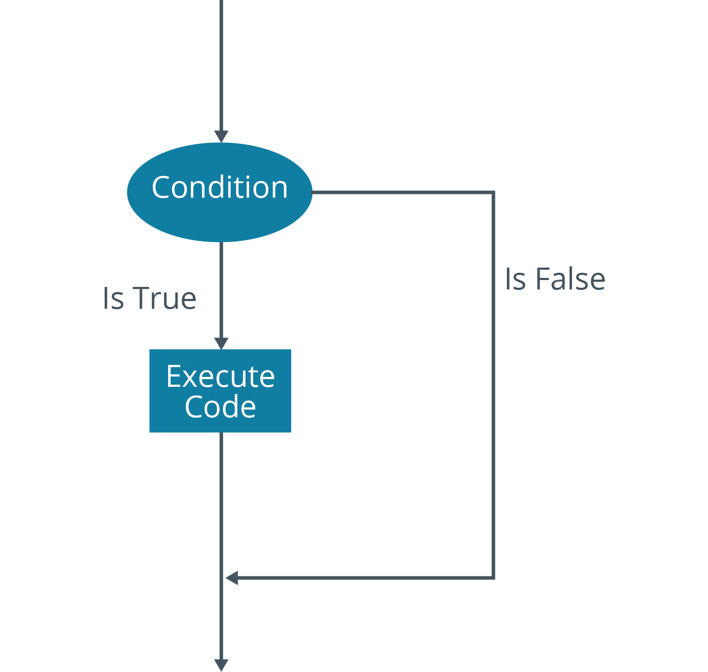
Conditional Statements (Slide 2 of 2)

Slide 72
The if Statement (Slide 1 of 2)
Primary conditional statement.
Contains condition to be evaluated and actions to perform if true.
If not true, actions are skipped.
End of if statement is indicated by fi statement.
Example:
var=5
if [ $var -gt 1 ]
then
echo "$var is greater than 1!"
fi

Slide 73
The if Statement (Slide 2 of 2)
Between square brackets is condition to be evaluated.
Is $var greater than 1?
Code within then statement is executed if condition is true.
The fi statement ends the entire if statement.
5 is greater than 1, so message is echoed.
If it weren't, nothing would happen.

Slide 74
The if…else Statement (Slide 1 of 2)
Enables a choice between two actions based on condition.
If condition is true, first action is performed.
If false, action within else is performed.
Use if…elif to evaluate more than two conditions.
Example:
var=1
if [ $var -gt 1 ]
then
echo "$var is greater than 1!"
else
echo "$var is less than or equal to 1!"
fi

Slide 75
The if…else Statement (Slide 2 of 2)
Value of $var has changed since prior example.
First echo command won't execute.
else statement specifies what happens if condition is false.
Prints different message to the screen.

Slide 76
The case Statement (Slide 1 of 3)
Many elif branches can evaluate many values a variable can have.
Difficult to read and maintain.
Use case instead.
Example on next slide.

Slide 77
The case Statement (Slide 2 of 3)
var=blue
case $var in
red)
echo "Your color is red."
;;
green)
echo "Your color is green."
;;
blue)
echo "Your color is blue."
;;
*)
echo "Your color is neither red, green, nor blue."
;;
esac

Slide 78
The case Statement (Slide 3 of 3)
First line defines the variable to evaluate.
Below that is first condition, red
Closing parenthesis indicates end of condition.
Next line is action to perform.
Double semicolons (;;) indicate end of action.
Pattern repeats as long as desired.
Wildcard (*) indicates everything else not matching prior conditions.
esac ends case statement.

Slide 79
Loops (Slide 1 of 2)
Control statements that execute code repeatedly based on a certain condition.
Another control statement besides conditionals.
Used to keep a block of code active until no longer needed.
Three types supported by Bash:
while
until
for
All three enclosed with do and done statements.

Slide 80
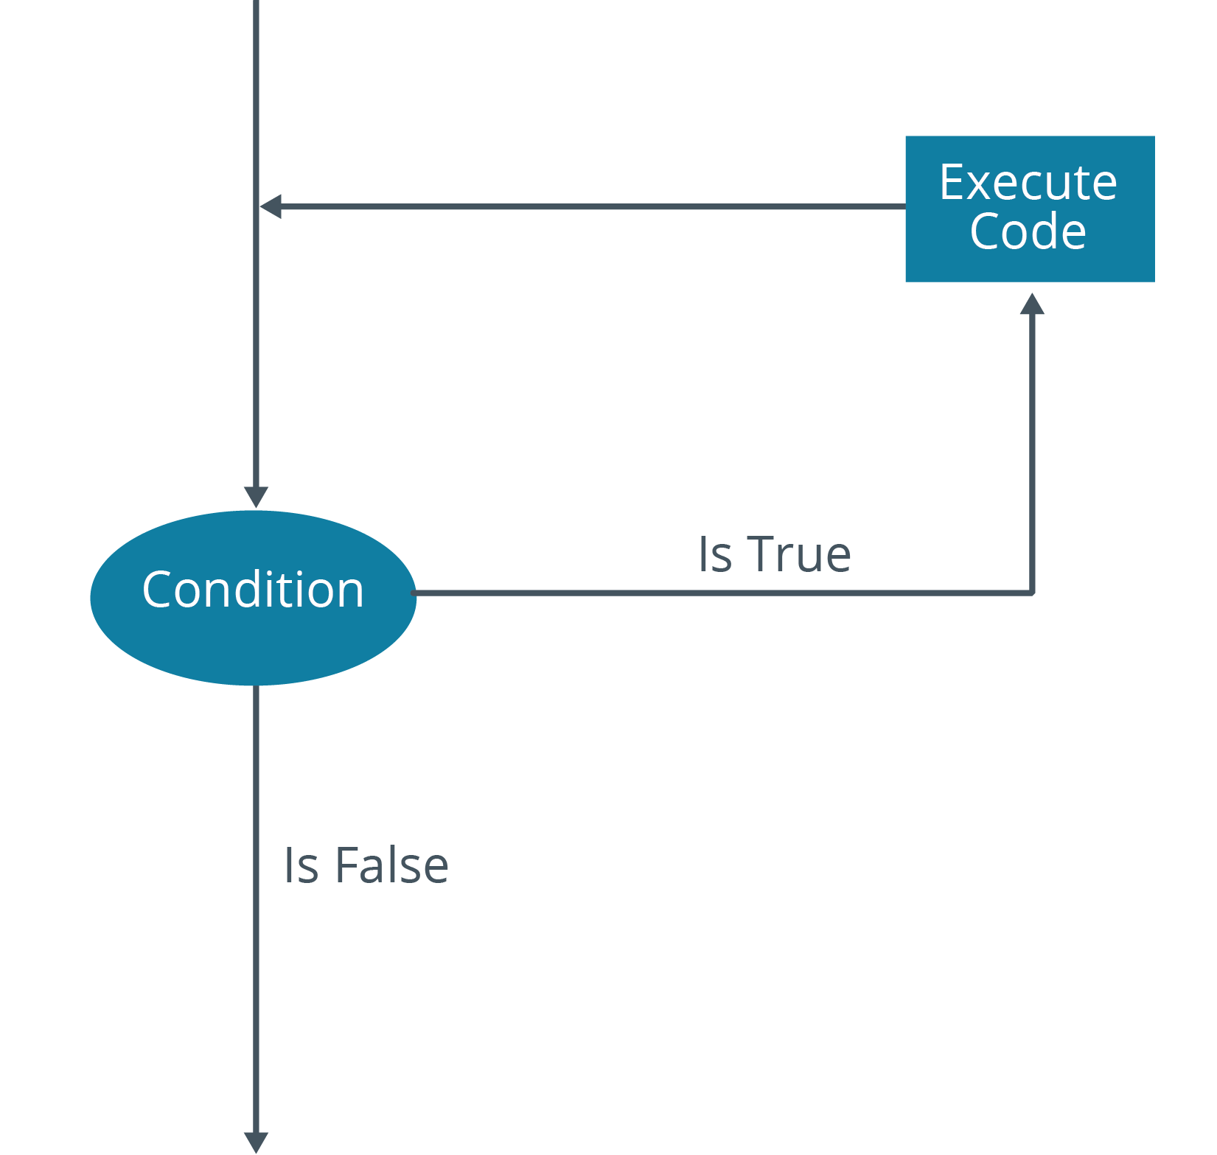
Loops (Slide 2 of 2)

Slide 81
The while Loop (Slide 1 of 2)
Enables you to repeat instructions while condition is met.
If expression is true, actions in loop are performed.
Execution returns to beginning of loop and evaluates expression again.
If expression becomes false, execution breaks out of loop.
Example:
var=1
while [ $var -le 5 ]
do
echo "The current number is $var."
((var++))
done

Slide 82
The while Loop (Slide 2 of 2)
Tests whether or not $var is less than or equal to 5.
As long as it is (true), code under do executes.
Below echo is an iterator.
Adds 1 to variable.
Common in loops.
Without iterator, $var will always be 1.
Execution will never leave the loop.

Slide 83
The until Loop
Similar to while, but executes code as long as condition is false.
Example:
var=1
until [ $var -ge 5 ]
do
echo "The current number is $var."
((var++))
done
Tests if $var is greater than or equal to 5.
Will execute code until it is.

Slide 84
The for Loop (Slide 1 of 2)
Executes code a specified number of times.
Doesn't depend on condition being true/false.
Meant to always execute code a given number of times.
Ideal for processing arrays.
Example:
var=("Carla" "Robert" "Mary")
for i in ${var[*]}
do
echo "$i is a member of the team."
done

Slide 85
The for Loop (Slide 2 of 2)
Evaluates every value in $var array.
Each value represented by i
Stands for iterator.
You can name it what you want.
Loop executes three times.
One for each value in array.
Each person's name is echoed.

Slide 86
Discussing Control Statements in Bash Scripts

Slide 87
Activity 13-6: Discussing Control Statements in Bash Scripts
What condition does the while loop test for?
ANSWER:
The while loop tests for true conditions.

Slide 88
Activity 13-6: Discussing Control Statements in Bash Scripts
You are creating a script that tests several conditions. Depending on the test outcome, you want one of three things to happen: send the results to a file, execute another script, or send all output to /dev/null. Which type of conditional statement can you use for this script?
ANSWER:
The if...elif statement tests several conditions and can perform different actions based on which condition is met. You can also use the case statement to achieve the same result.

Slide 89
Activity 13-6: Discussing Control Statements in Bash Scripts
You have created a script to check the existence of a file. If the file exists, you want to have the script echo the word "Success" and then exit with an exit code of 0. Otherwise, it should echo "Doesn't exist". Where in the script should you place the exit 0 code?
ANSWER:
Within the if...then branch that tests the condition that the file exists, before the else branch.

Slide 90
Activity 13-6: Discussing Control Statements in Bash Scripts
True or false? There is a limit to the number of conditions in a case statement.
ANSWER:
False. You can have as many conditions as necessary.

Slide 91
Activity 13-6: Discussing Control Statements in Bash Scripts
Your colleague has written a script with an array called names that holds the names of various users. In the script, a for loop iterates through each value in the array. The script is supposed to echo each name to the CLI, but instead, it only echoes the first name in the array multiple times. You confirm that the for loop has the proper syntax, so the problem must lie elsewhere. What do you think the problem is with the script?
ANSWER:
It's likely that the echo statement within the for loop is referencing the $names array directly, whereas it should be referencing the iterator variable instead.

Slide 92
Activity: Incorporating Conditional Statements in Bash Scripts
Script should be more useful to admins who need to view reports.
Enable script to make decisions based on conditions.
You'll use if statements to output different messages.
Based on thresholds of percentage full.
Devices close to full will trigger an urgent warning.
Less full devices will trigger less urgent messages.
Notes:
Teaching Tip: The finished version of the script students create in this activity has been provided as
check_storag
e_if.sh. You may wish to demonstrate the script rather than have students type it out, especially if you need to save time.

Slide 93
Activity: Incorporating Loops in Bash Scripts
Script still needs improvement.
You want to output status of all storage devices.
You need to do this programmatically, not statically.
Devices are likely to change.
You'll leverage a for loop.
Iterate over all devices and perform necessary checks.
Notes:
Teaching Tip: The finished version of the script students create in this activity has been provided as
check_storag
e_for.sh. You may wish to demonstrate the script rather than have students type it out, especially if you need to save time.

Slide 94
What environment variables might you configure in your shell environment?
What are the various tasks that you might perform in your environment by running a shell script?

